Slide 1

ANUGRAHA INSTITUTE OF SOCIAL SCIENCE,
NOCHIODAIPATTY,DINDIGUL-624 003
DEPARTMENT OF PHYSICS
COURSE NAME :
DATA LITERACY WITH TABLEAU
PROJECT NAME : SUBSCRIBERS GALONE EXPLORING WORLD TOP
YOUTUBE CHANNELS
MENTOR :
S.SAHAYA RAJAN
TEAM MEMBERS :
LEADER : R.SIVA
MEMBERS : 1.N.ANANTHI
2.M.BHUVANESHWARI

Slide 2
TABLEAU DEESKTOP (BUSINESS ANALYTICS ANYONE CAN USE)
Tableau desktop is a data visualization application
To facilitate you to examine virtually any
Kind of structured data and generate highly
Interactive , beautiful graphs ,
dashboard
, and reports within minute.

Slide 3
Features of Tableau
Tableau Dashboard
Collaboration & sharing
Live & In-memory Data
Data Source
Robust Security
6 Mobile View

Slide 4
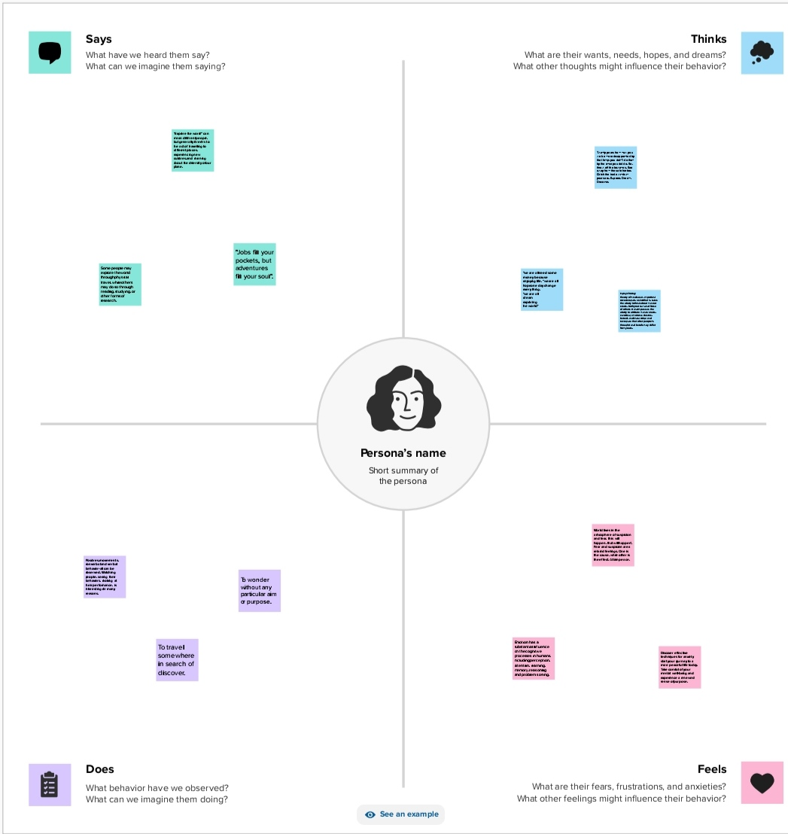
EMPATHY MAP

Slide 5
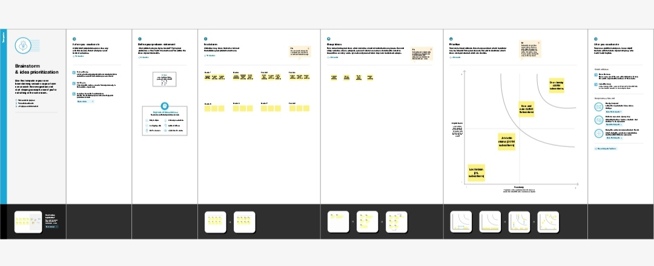
BRAINSTORMING

Slide 6
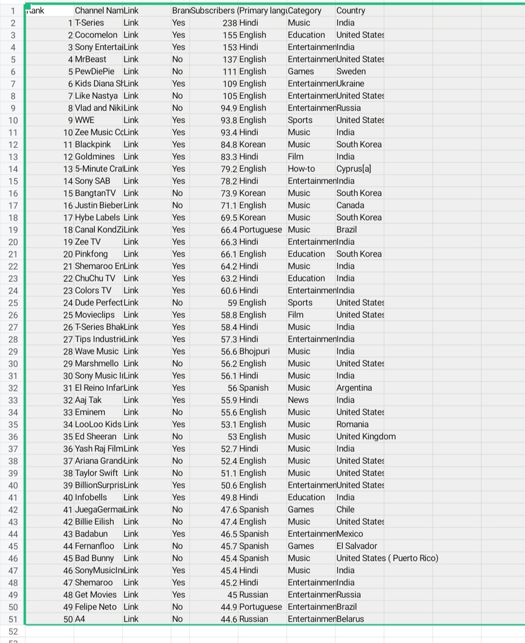
Data set

Slide 7
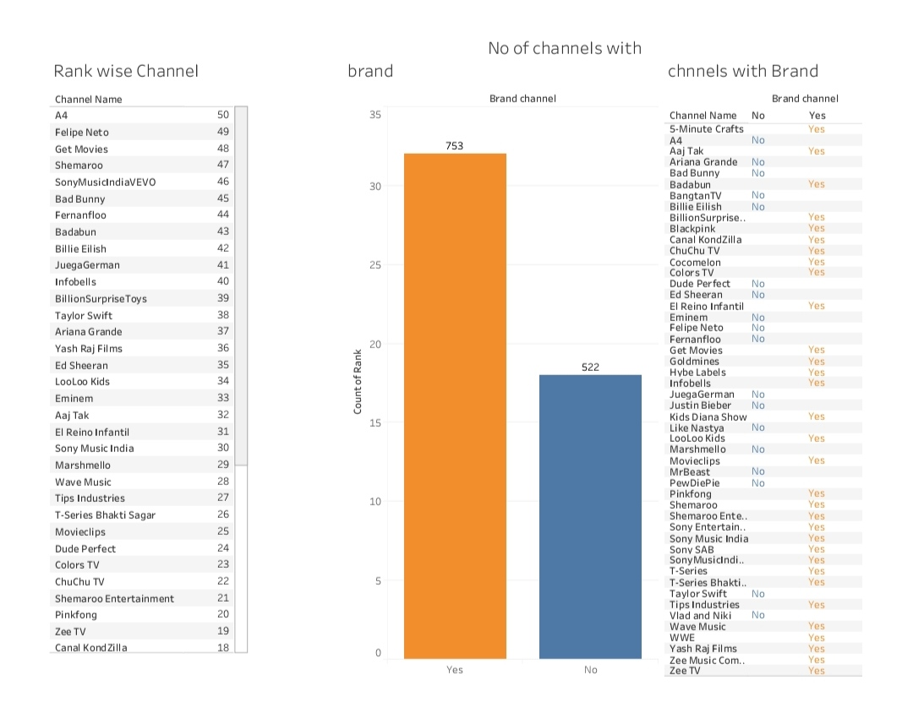
Dashboard 1

Slide 8
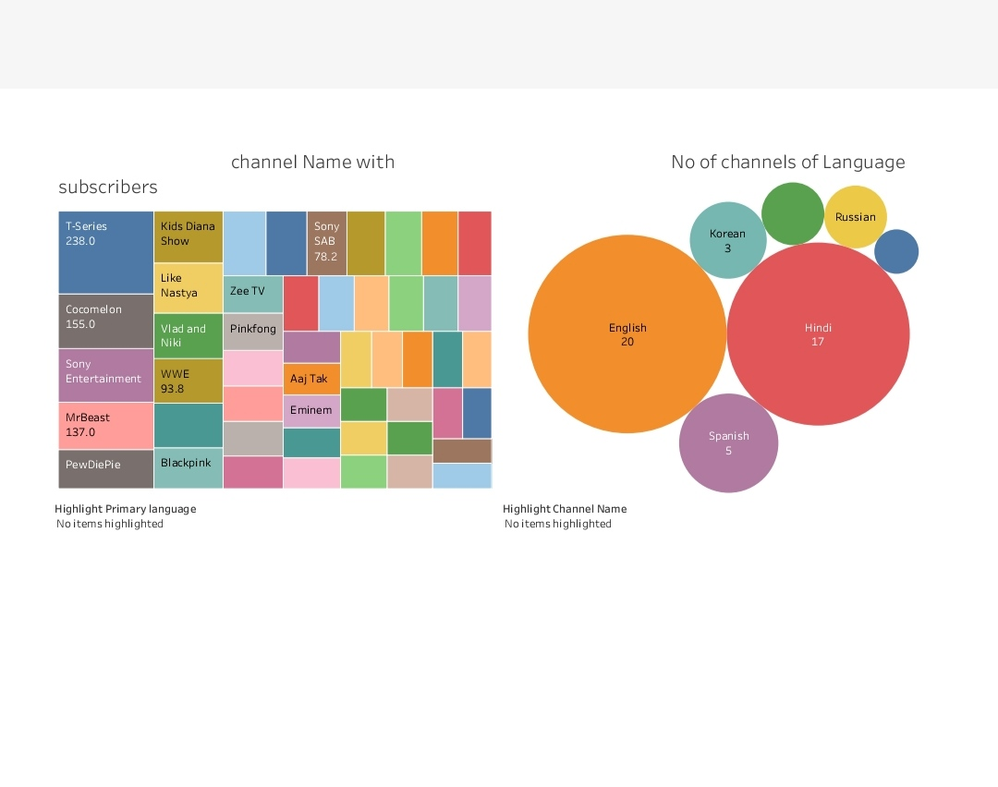
Dashboard 2

Slide 9
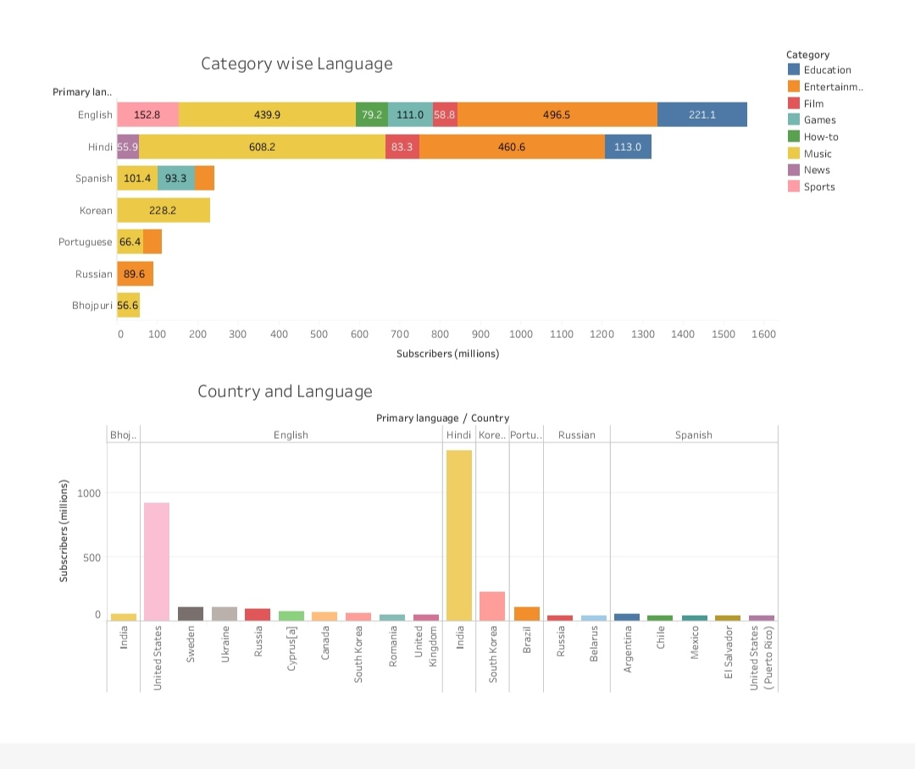
Dashboard 3

Slide 10
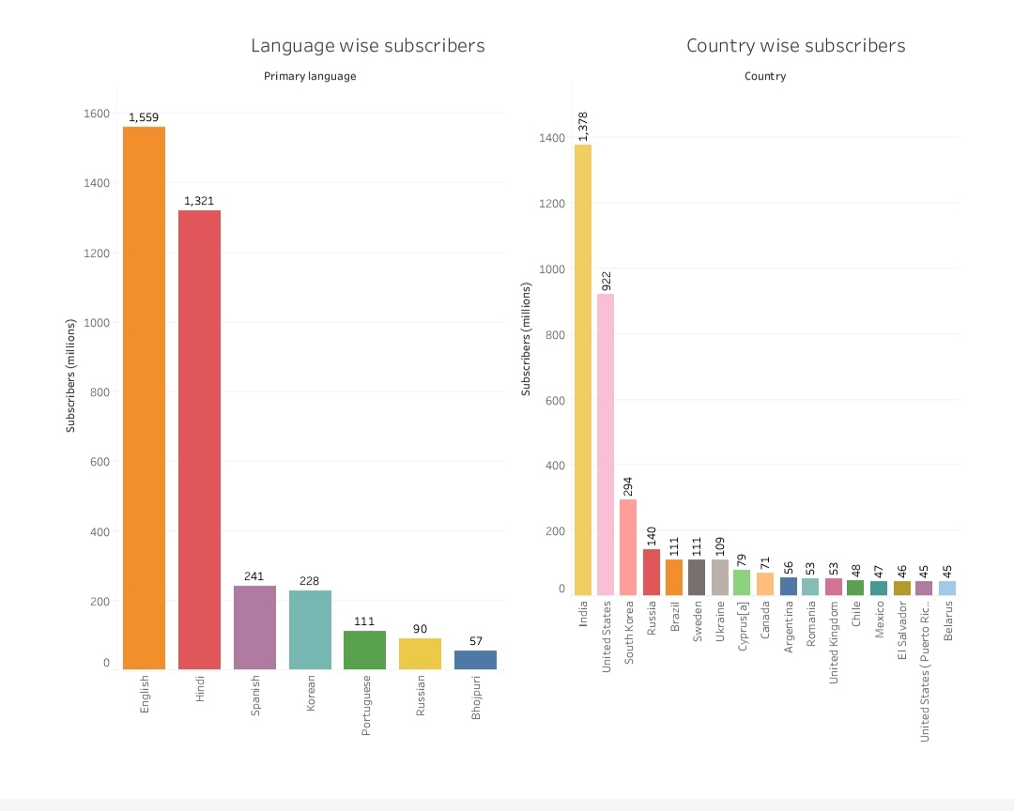
Dashboard 4

Slide 11
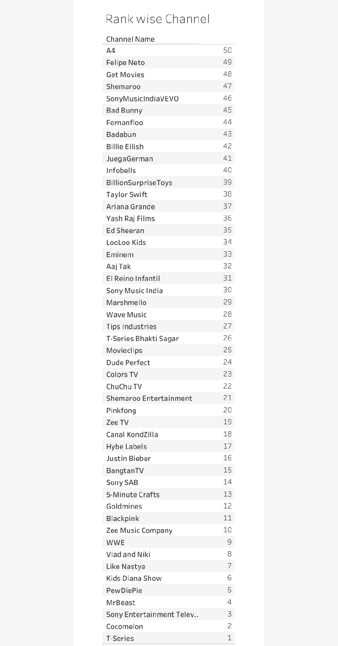
Story

Slide 12
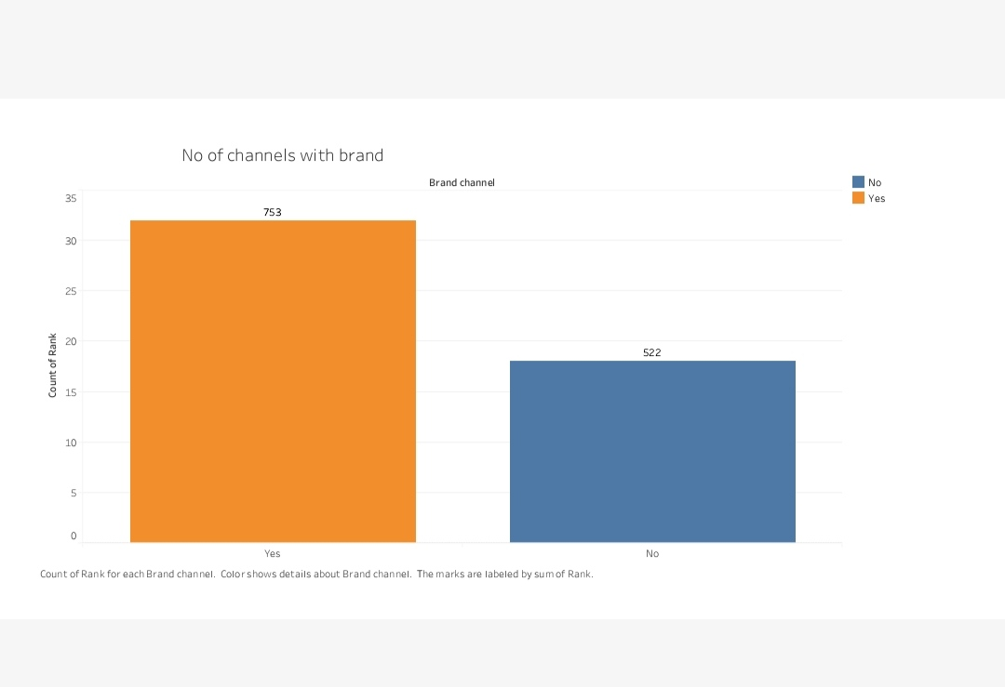

Slide 13
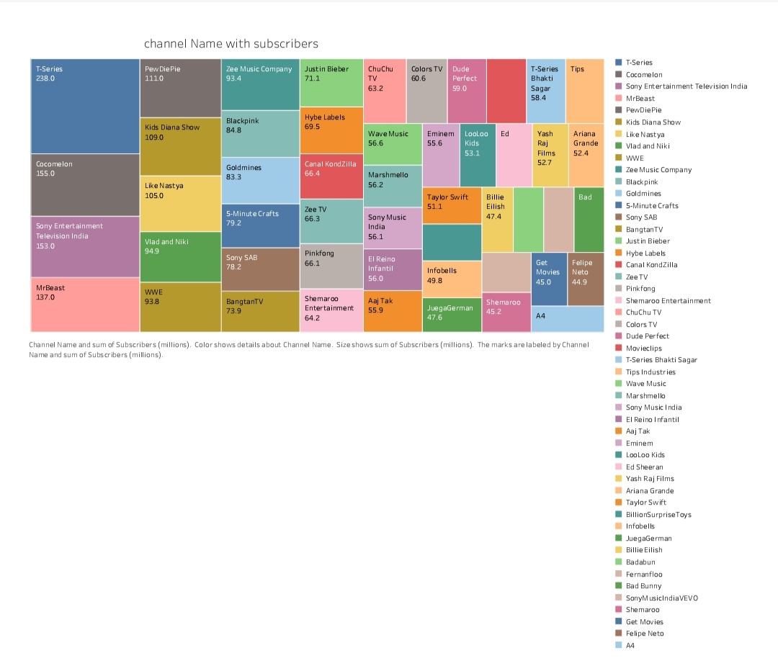

Slide 14
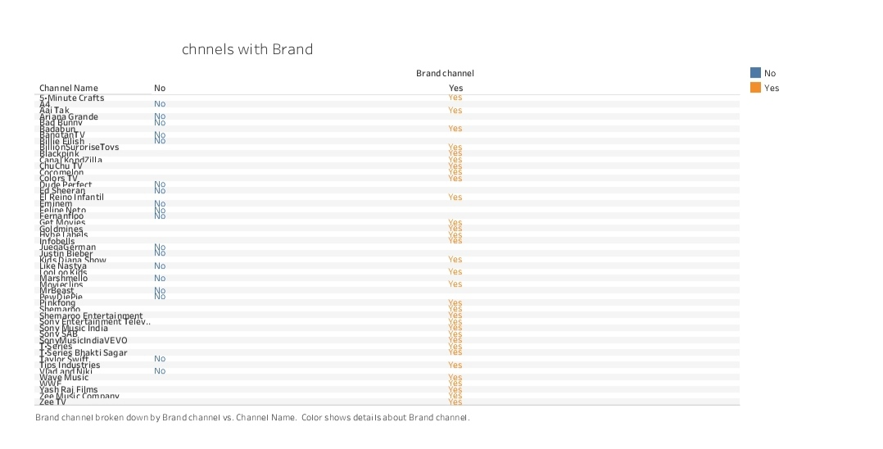

Slide 15
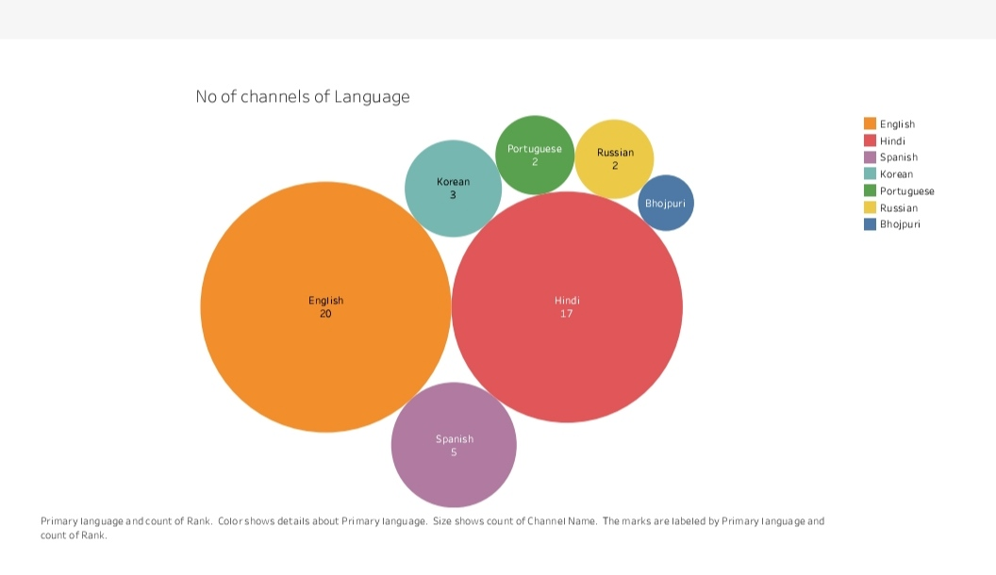

Slide 16
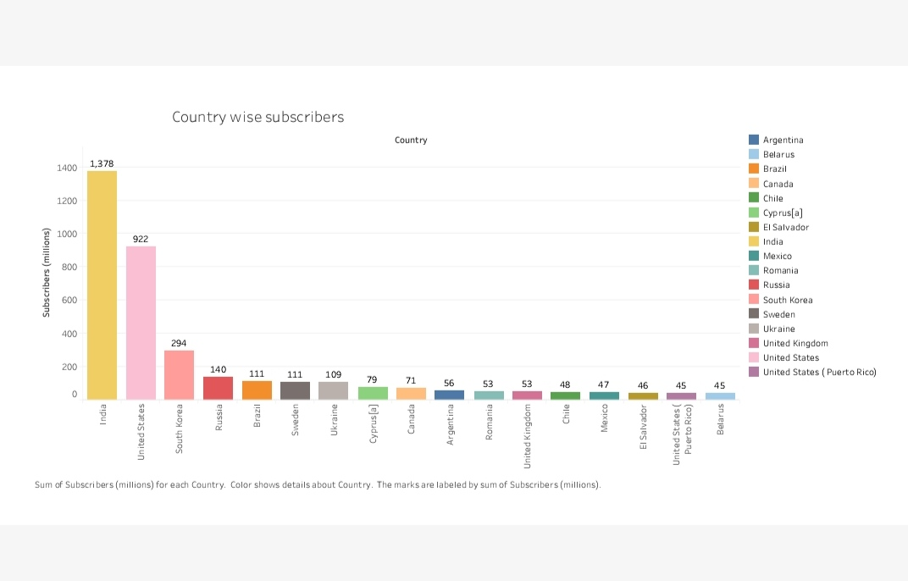

Slide 17
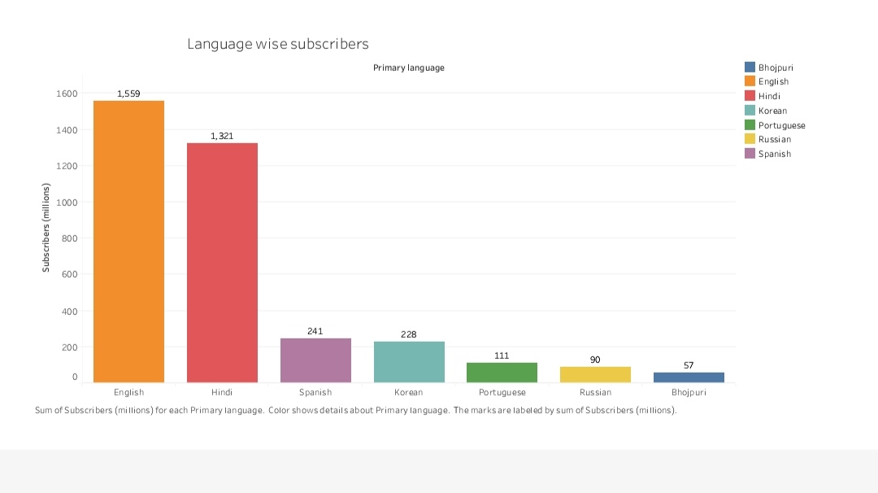

Slide 18
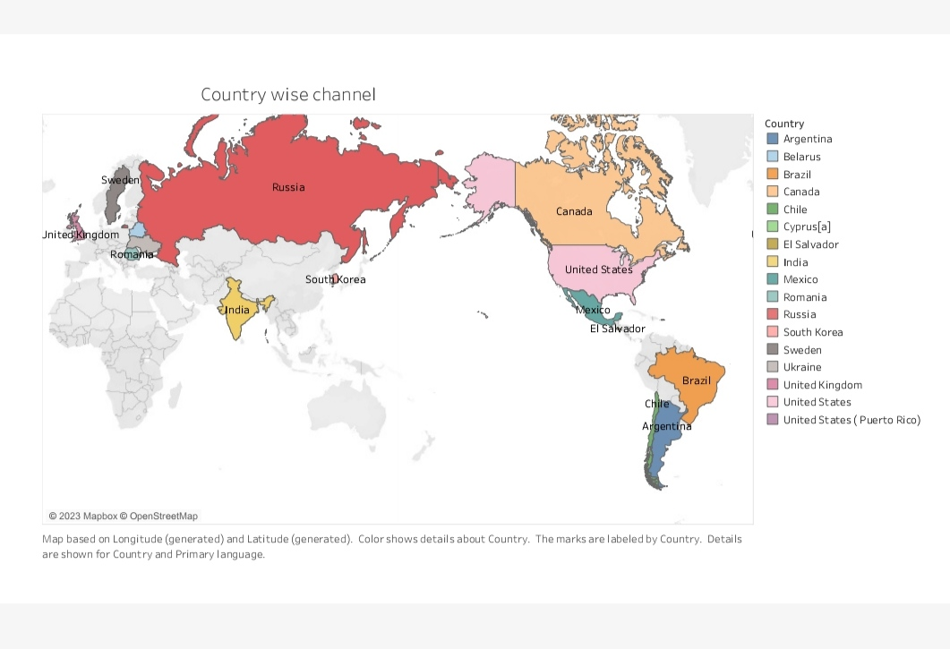

Slide 19
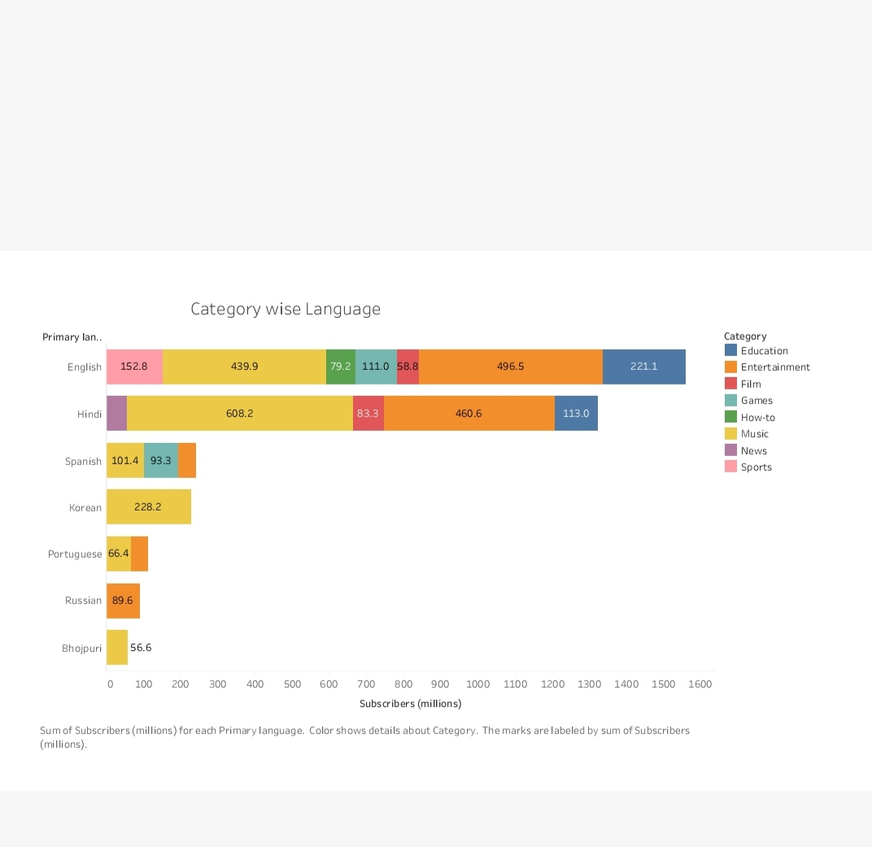

Slide 20
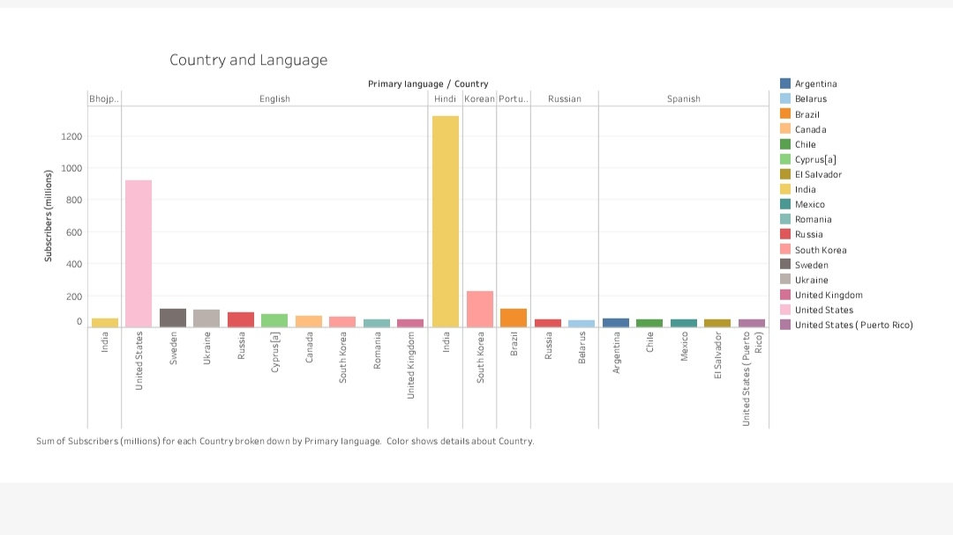

Slide 21
MY DASH BOARD LINK :
https://public.tableau.com/views/Book1_17002070649490/Dashboard2?:language=en-US&publish=yes&:display_count=n&:origin=viz_share_link
https://public.tableau.com/views/Book1_17002070649490/Dashboard2?:language=en-US&publish=yes&:display_count=n&:origin=viz_share_link
https://public.tableau.com/views/Book1_17002070649490/Dashboard3?:language=en-US&publish=yes&:display_count=n&:origin=viz_share_link
https://public.tableau.com/views/Book1_17002070649490/Dashboard4?:language=en-US&publish=yes&:display_count=n&:origin=viz_share_link
My Story Link
https://public.tableau.com/shared/5ZKFMWQFR?:display_count=n&:origin=viz_share_link

Slide 22
CONCLUSION :
Tableau is an excellent program to simplify all your data
Visualization activities
And provide better and more accurate analysis is you’ve
ever tried data visualization
And found it though to grasp or too complecx

Slide 23
THANK YOU

